Slide 2

Power BI / FABIC
Licensing
made simple
Notes:
Photo by NeONBRAND on Unsplash

Slide 3

Trust, but verify.
Ronald Regan
Notes:
Photo by Cytonn Photography on Unsplash

Slide 4

Notes:
This session is going to quick, fast and fun !

Slide 5

bit.ly/3pBLowQ

Slide 6
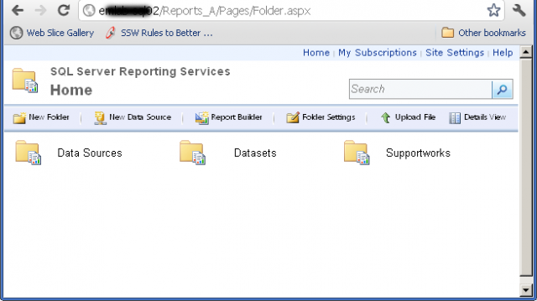

Slide 7


Slide 8
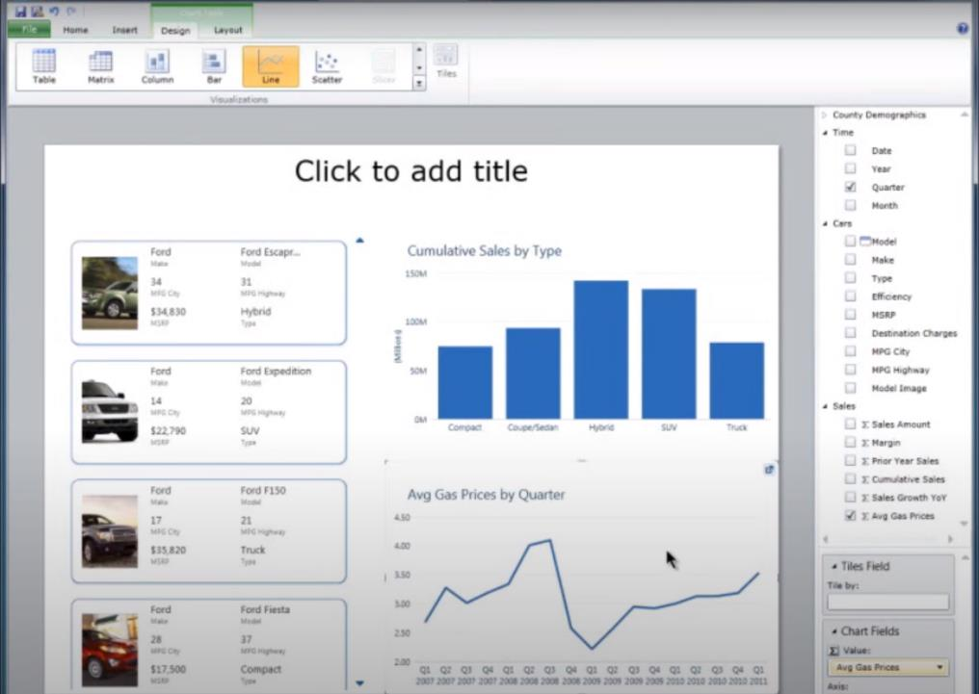

Slide 9

Notes:
Photo by Mari Helin on Unsplash

Slide 10

Notes:
Photo by Jakob Boman on Unsplash
No choice I had dive and start exploring

Slide 11

This Photo by Unknown Author is licensed under CC BY-NC-ND

Slide 12


Slide 13

Notes:
Photo by Nghia Le on Unsplash

Slide 14

Notes:
Photo by Emily Morter on Unsplash
What do I mean by an SME?

Slide 15
Definition
Small to Medium Enterprise
Headcount < 250 people
Turn over <= £25 million
https://en.wikipedia.org/wiki/Small_and_medium-sized_enterprises

Slide 16
99.3%
“The Department for Business Innovation and Skills estimated that at the start of 2014, 99.3% of UK private sector businesses were SMEs” https://en.wikipedia.org/wiki/Small_and_medium-sized_enterprises#United_Kingdom

Slide 17

Notes:
Photo by Matthew Henry on Unsplash

Slide 18

Notes:
Photo by Ryan Franco on Unsplash

Slide 19

Notes:
Photo by Andrea Piacquadio from Pexels

Slide 20

Notes:
Photo by Diana Parkhouse on Unsplash

Slide 21

Notes:
Photo by <a href="https://unsplash.com/@rossfindon?utm_source=unsplash&utm_medium=referral&utm_content=creditCopyText">Ross Findon</a> on <a href="https://unsplash.com/photos/mG28olYFgHI?utm_source=unsplash&utm_medium=referral&utm_content=creditCopyText">Unsplash</a>

Slide 22


Slide 23
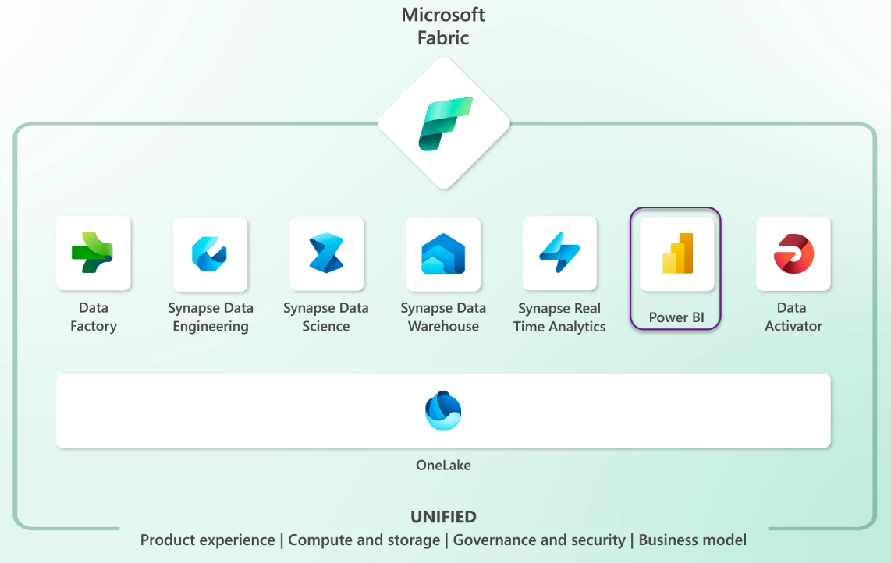

Slide 24


Slide 25


Slide 26

Notes:
What is the goal of this presentation?

Slide 27

Notes:
Give the user a full overview of all the licence options available to Power BI
From Microsoft and third parties
So will be more a broad brush overview of the entire landscape.
Also some of the options ARE NOT THAT OBVIOUS

Slide 28

Notes:
Photo by Alexandra Georgieva from Pexels
Some parts of this presentation are going to be rather shallow

Slide 29

Notes:
Photo by Camylla Battani on Unsplash
Chances you will leave the presentation with some answers, which will lead to more questions

Slide 30


Good
Bad
Notes:
We will cover both the Good and Bad aspects of each option as I see them, feel free to disagree

Slide 31


Slide 32


Slide 33


Notes:
Photo by William White on Unsplash
This is now call a Fabric licence

Slide 34



Slide 35


Power BI Premium Per User
Notes:
Power Bi Per User Licence
Photo by Papaioannou Kostas on Unsplash

Slide 36

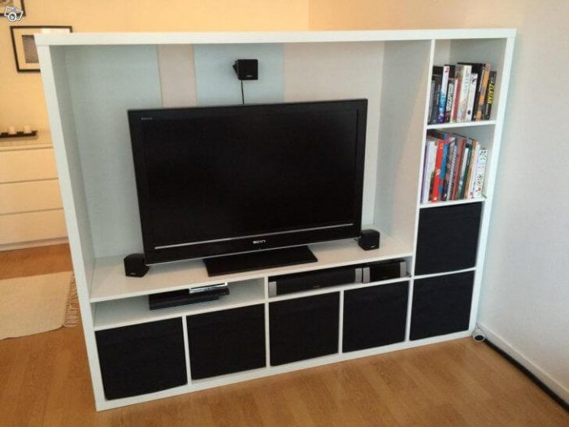
Power BI Embedded
Notes:
https://enthusiasthome.com/diy-entertainment-center/

Slide 37


Power BI Premium
Notes:
Photo by Jp Valery on Unsplash

Slide 38


Notes:
Photo by Diana Parkhouse on Unsplash

Slide 39

Robert French
Data Shepherd,
Data Plumber ,
Data Dance Teacher
Email -
Robert.French@qnrl.com
@sqlbobscot
#DressUpFriday
Linked In - https://www.linkedin.com
/in/rwlpfrench/
Website - https://www.qnrl.com/

Slide 40

Notes:
Photo by Romain Vignes on Unsplash
First we have to explain some terms

Slide 41

Notes:
First though there are two BROAD types of license
Photo by Waldemar Brandt on Unsplash

Slide 42
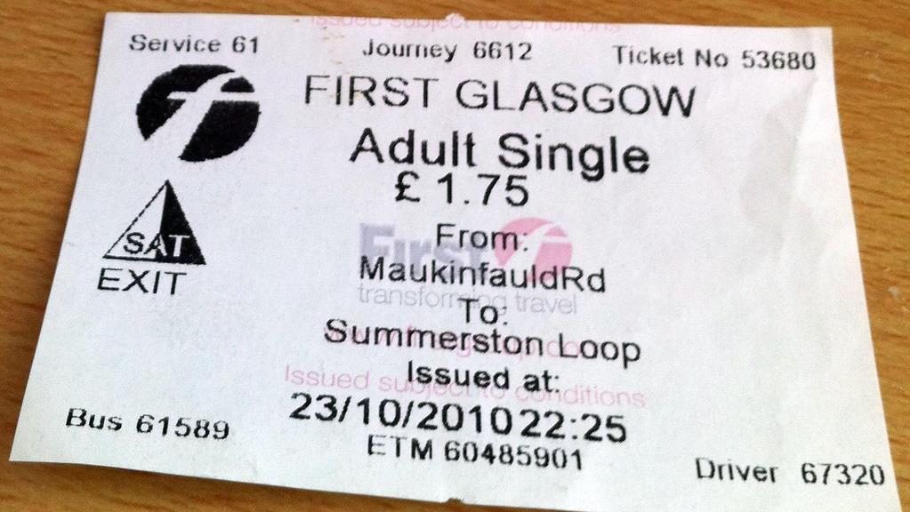
User license
Notes:
Personal license – to allow anyone to ride on a bus in Glasgow you have purchase a ticket, this could be a season ticket so you can ride at any time. Only one person at a time can use that ticket though

Slide 43

Capacity License
Notes:
What if your company wants to transport 60, or 100 people regularly. More people it becomes cheaper to rent the entire bus

Slide 44
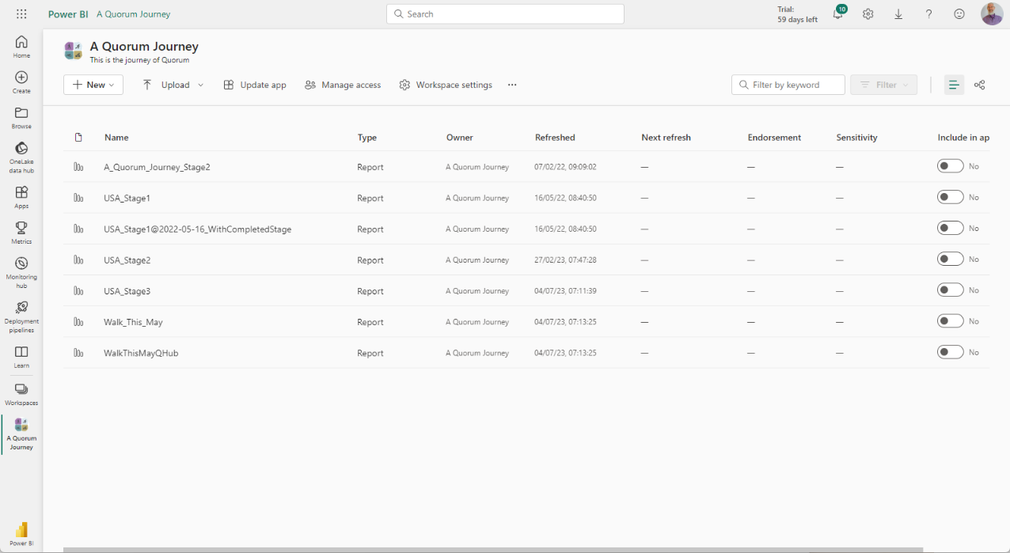

Slide 45
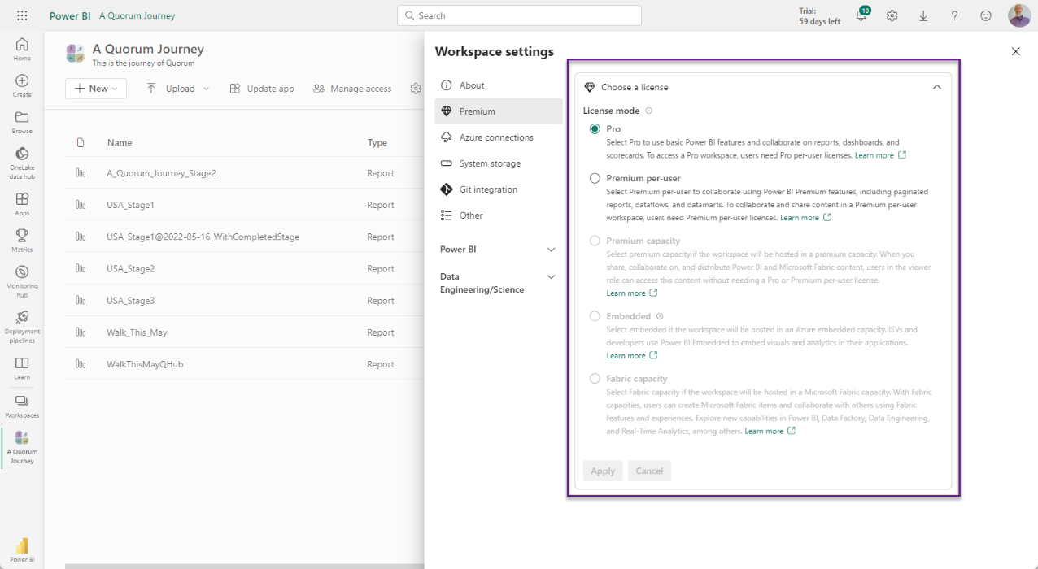

Slide 46
Notes:
Photo by William White on Unsplash

Slide 47
Notes:
What are the upsides of Power BI Free

Slide 48
User license
Notes:
Personal license – to allow anyone to ride on a bus in Glasgow you have purchase a ticket, this could be a season ticket so you can ride at any time. Only one person at a time can use that ticket though

Slide 49

Free to download and use

Slide 50
Cost = £0.00p

Slide 51
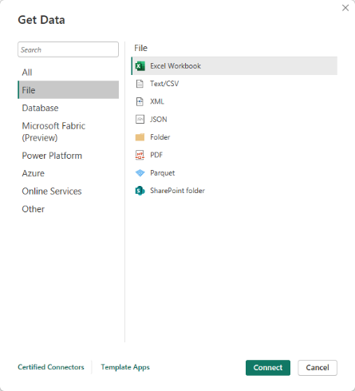
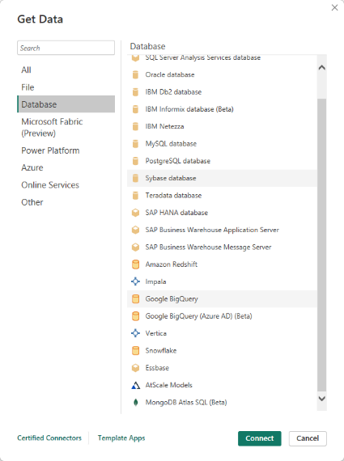
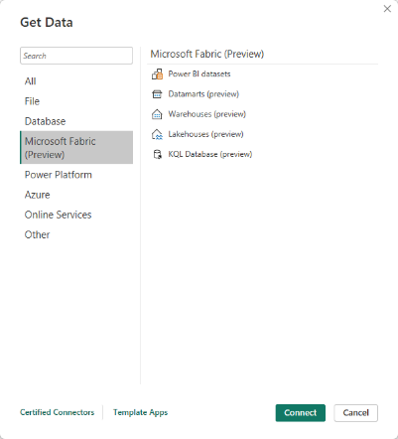
Notes:
Can import data from a wide variety of sources 100+
1/3

Slide 52
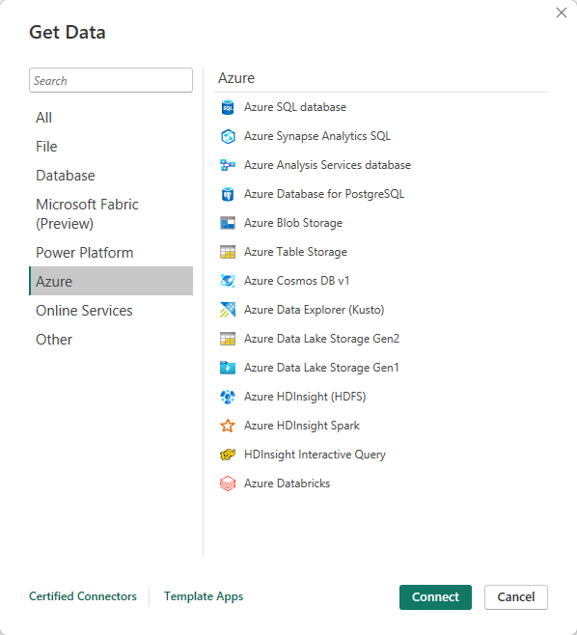
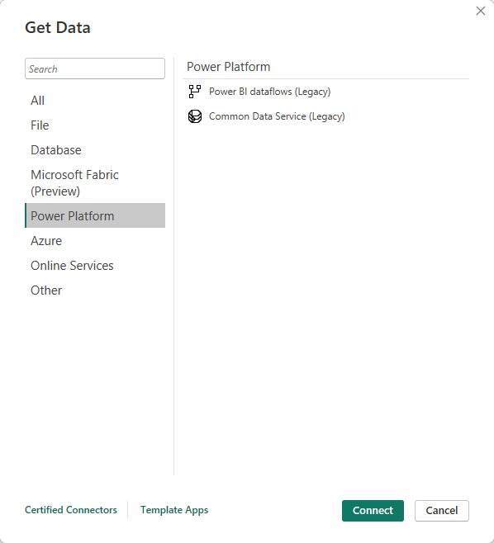
Notes:
Can import data from a wide variety of sources 100+
2/3

Slide 53
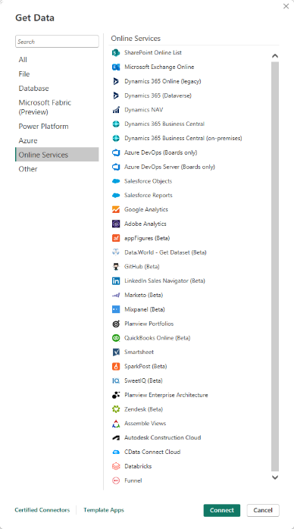
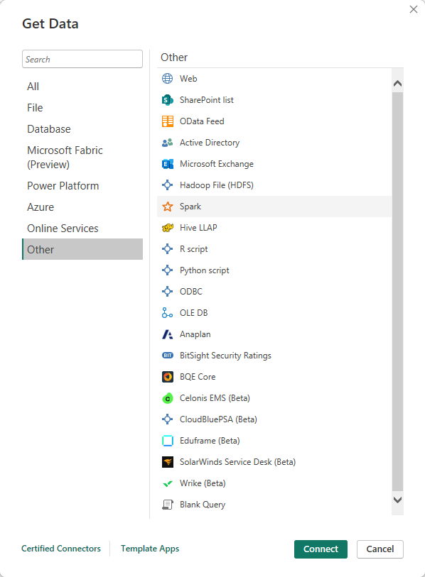
Notes:
Can import data from a wide variety of sources 100+
3/3

Slide 54
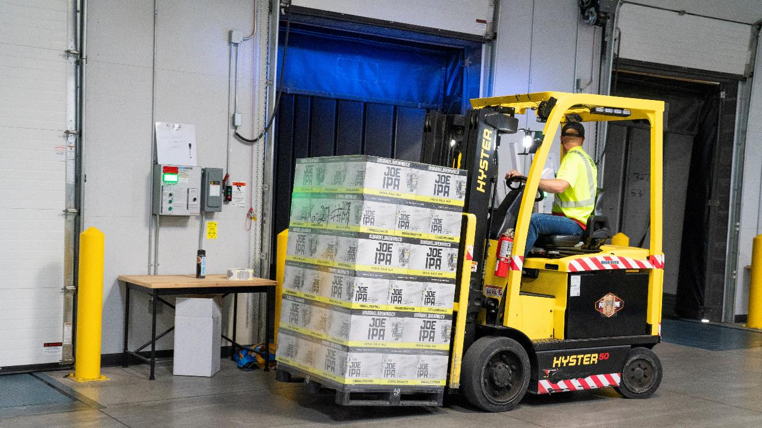
Notes:
Photo by ELEVATE from Pexels
Also get a fantastic ETL tool as well built into Power BI Desktop
Informatica
Alteryx
Talend
QlikView Expressor
Tableau Data Prep
SQL Server Integration Services SSIS

Slide 55

Notes:
Photo by Pixabay from Pexels
There is also a Datawarehousing tool built into Power BI Desktop

Slide 56
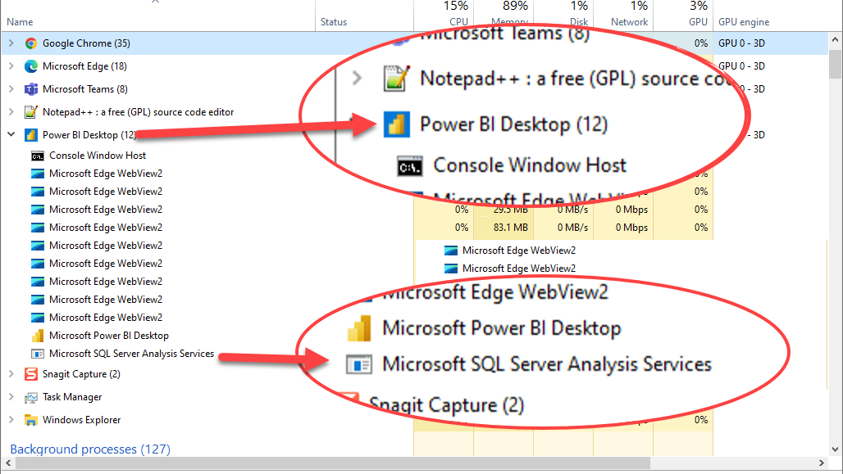
Notes:
Power BI desktop is running an instance of SQL Server Analysis Services

Slide 57

Notes:
Photo by Timur Saglambilek from Pexels
There is some amazing analytics capabilities built into Power BI

Slide 58
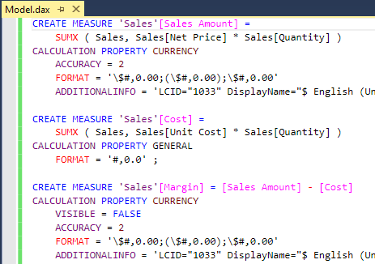
Notes:
DAX is an entire language just for working with data

Slide 59
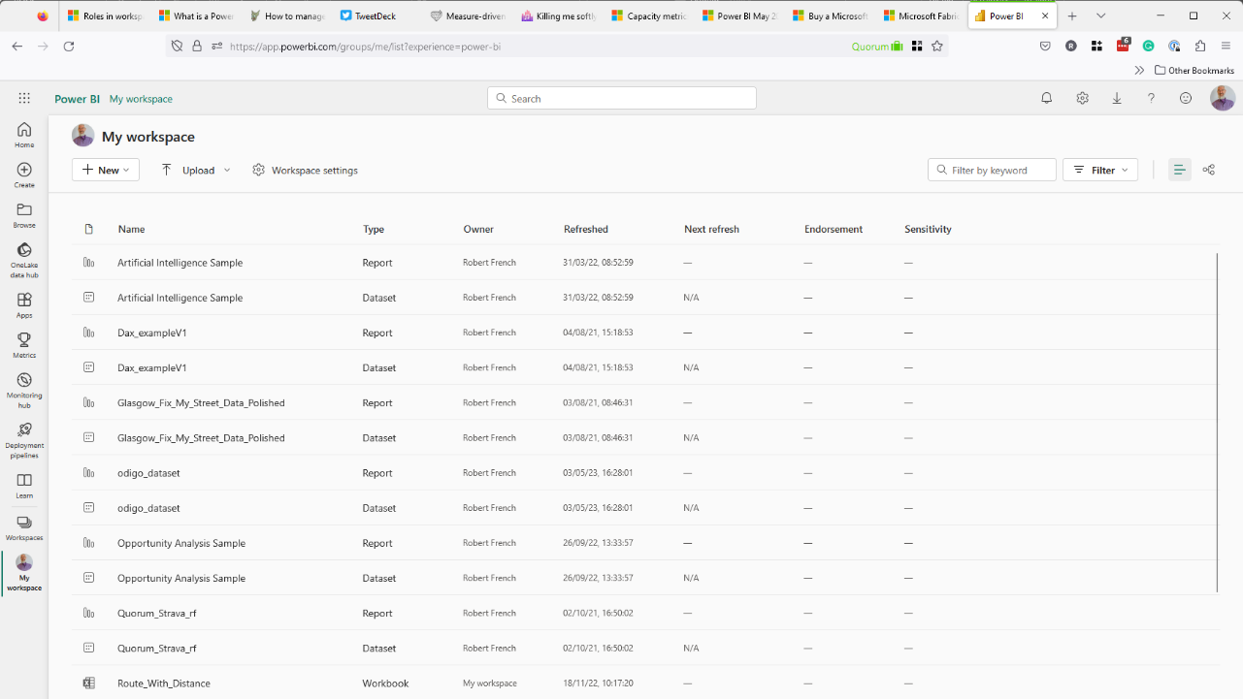
Notes:
You get access to a workspace in the Power BI service for free
A workspace can contain both reports and other entities

Slide 60
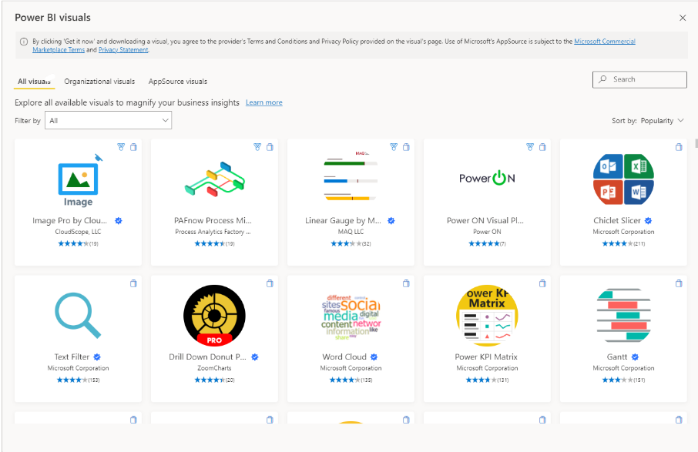

Slide 61

Notes:
Photo by Spencer Davis on Unsplash
It is possible to share the reports freely on the internet

Slide 62

Notes:
Photo by Ben White on Unsplash
Can share desktop files for free with anyone who has the application

Slide 63
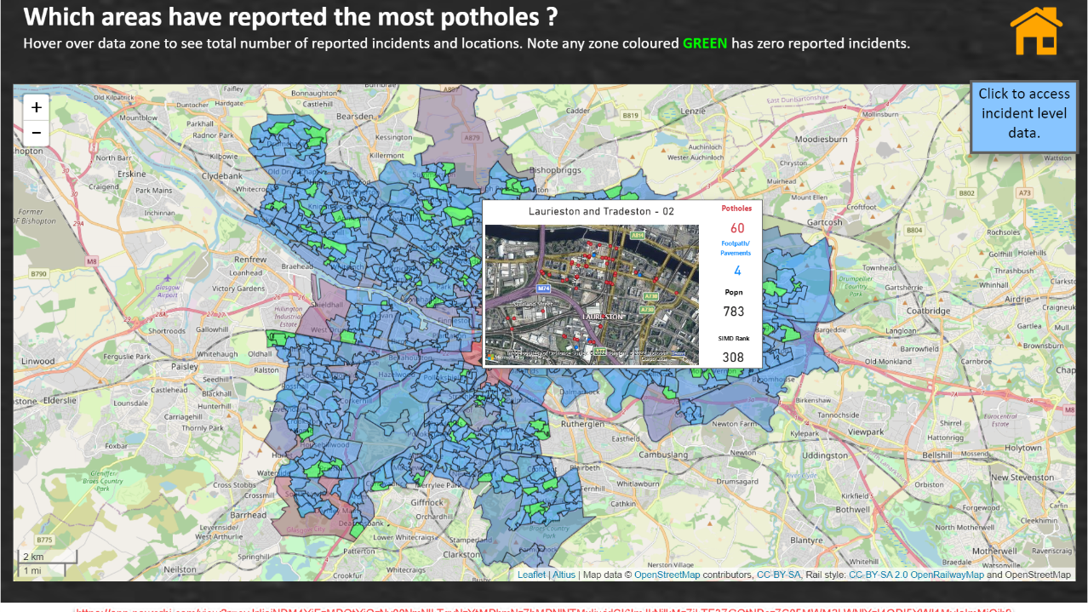
Notes:
https://app.powerbi.com/view?r=eyJrIjoiY2VlMjg1MmQtMzFhZi00NzY1LThjZTUtMWI2MjM5ODFhYjUzIiwidCI6ImJkNjlkMzZiLTE3ZGQtNDczZC05MWM2LWNlYzI4ODI5YWI1MyIsImMiOjh9
Can share reports on the internet for free, there a catch we will discuss that later

Slide 64
Cost = £0.00p

Slide 65
Access to Power BI Service
Own workspace to upload reports into.

Slide 66
Notes:
It allows access to all the access fabric features that account is permitted to access.
If the capacity is running

Slide 67
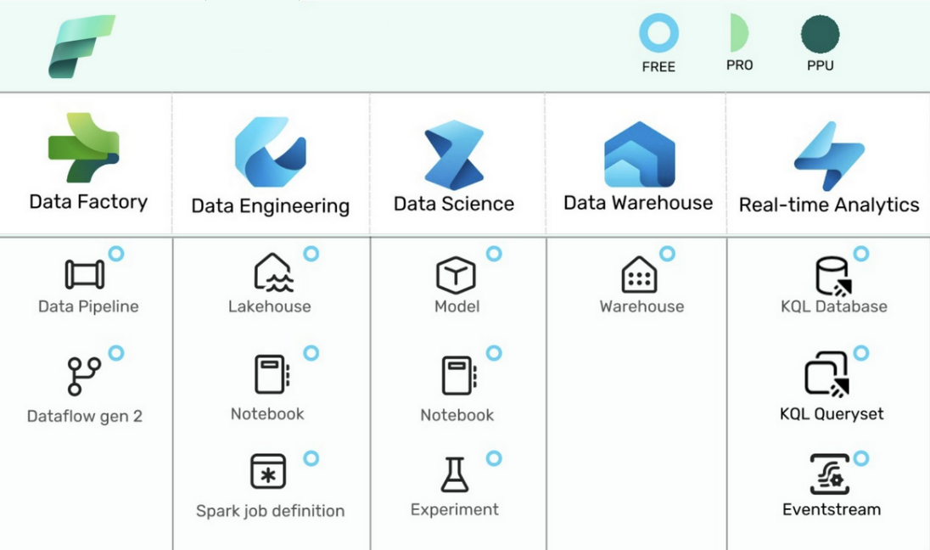
July 2023 – non power bi entities in workspace
Backed by a Fabric Capacity (F-SKU or P SKU)
https://learn.microsoft.com/en-us/fabric/enterprise/licenses#capacity-and-skus

Slide 69
Notes:
https://app.powerbi.com/view?r=eyJrIjoiY2VlMjg1MmQtMzFhZi00NzY1LThjZTUtMWI2MjM5ODFhYjUzIiwidCI6ImJkNjlkMzZiLTE3ZGQtNDczZC05MWM2LWNlYzI4ODI5YWI1MyIsImMiOjh9
Can share the reports this is public so NO SECURITY

Slide 70

Notes:
Photo by chris panas on Unsplash

Slide 71
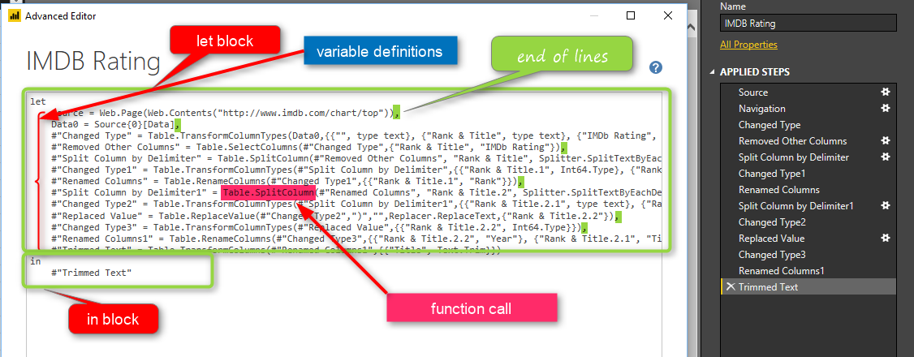
https://radacad.com/basics-of-m-power-query-formula-language
Notes:
There is not just one language new in Power BI desktop there is TWO LANGUAGES
DAX and M (or Power Query Language) both with different purposes and functions

Slide 72

Notes:
There is not support, there is lots o

Slide 73

This Photo by Unknown Author is licensed under CC BY
Notes:
There is a very large community offering support

Slide 75


Slide 76
Cost
£8.20 per month
£98.4 per year
(At June 2023)

Slide 77
User license
Notes:
Personal license – to allow anyone to ride on a bus in Glasgow you have purchase a ticket, this could be a season ticket so you can ride at any time. Only one person at a time can use that ticket though

Slide 78
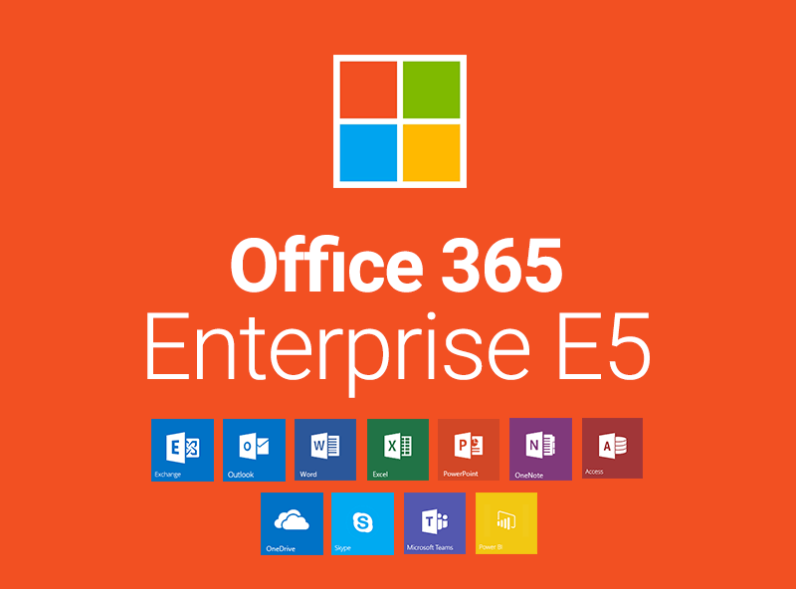
Notes:
Included with Office 365 E5 licence

Slide 79
Notes:
It allows access to all the access fabric features that account is permitted to access.
If the capacity is running

Slide 80
Notes:
What are the upsides of Power BI Pro

Slide 81
Notes:
Photo by Spencer Davis on Unsplash
You can share reports with other people if they have a PowerBI Pro Licence

Slide 82
Notes:
Photo by chris panas on Unsplash
Can share securely using Office 365 or Power BI Service IF the other user has POWER BI PRO

Slide 83
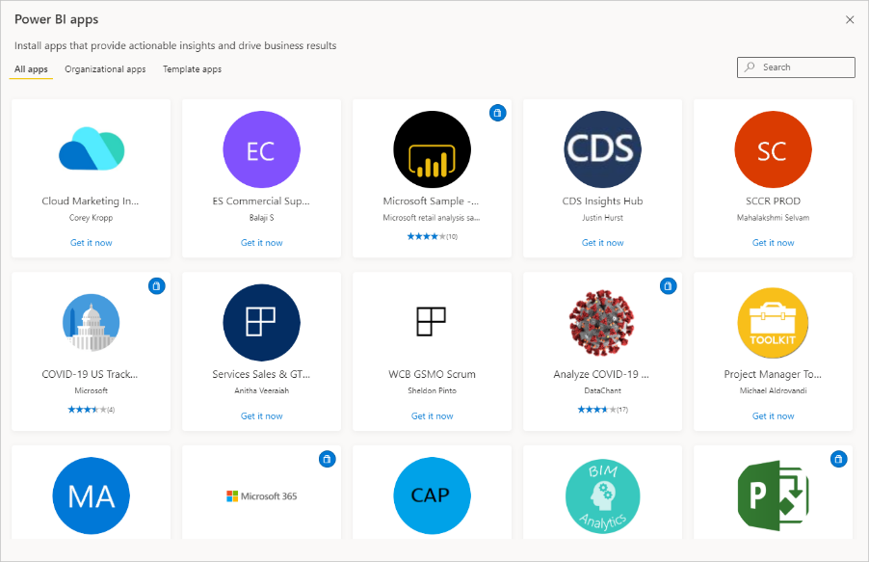
Notes:
Can use and publish Power Bi Apps – these4 are free apps typicall
Apps are dashboards and reports all pre-packaged ready to download and use – can get them in the AppSource
Twitter sentiments
Facebook Adverts
Sage 300
YouTube Analytics Report
Google Analytics Reports

Slide 84
Power BI Apps
<>
PowerApps

Slide 85

Notes:
Can use Office 365 security to grant permissions to view the reports including using Office 365 groups

Slide 86

Power BI
Data gateway
Notes:
Can use data gateways to access on prem sources using data gateway

Slide 87


Slide 88
Access to Power BI Service
Own workspace to upload reports to
8 refreshes per day
Dataset incremental refresh
Securely share with other pro license users

Slide 90

Notes:
Photo by Laura Dewilde on Unsplash
The reports are hosted on a shared server when published to PowerBi.com so if its busy then could be slower then expected.

Slide 91
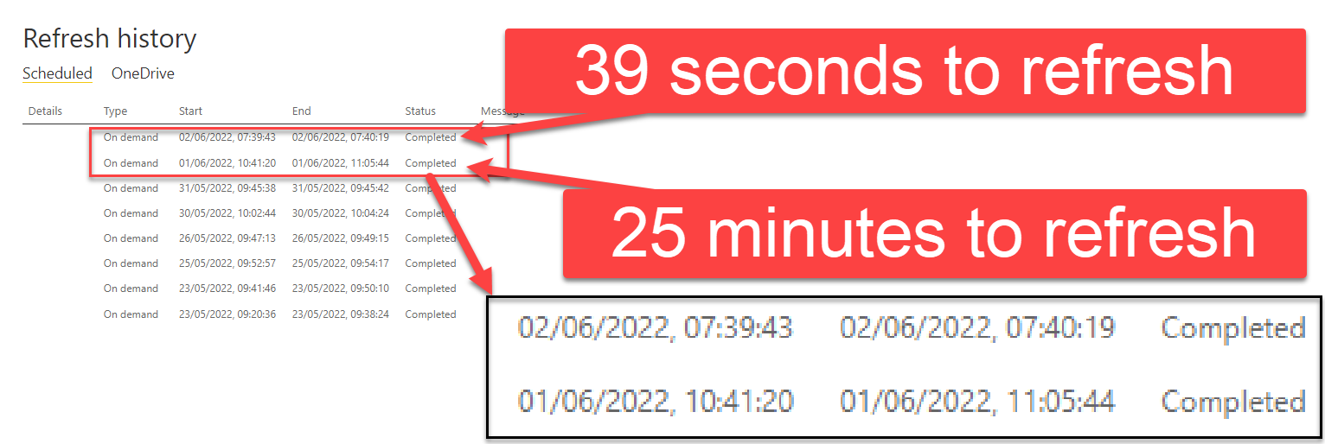
Same report refreshed
In Power BI Pro workspace

Slide 92

No Pro License No Secure Sharing
Notes:
Photo by Elaine Casap on Unsplash
The person you want to share with must have a Power BI Licence if want to share securely

Slide 93
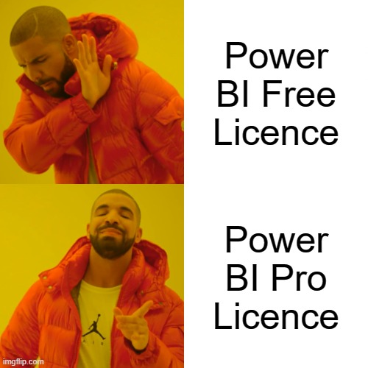

Slide 94
Power BI Premium Per User
Notes:
Power Bi Per User Licence
Photo by Papaioannou Kostas on Unsplash

Slide 95



Slide 96
Cost
£16.40 per month
£196.80 per year
(At June 2023)

Slide 97
User license
Notes:
Personal license – to allow anyone to ride on a bus in Glasgow you have purchase a ticket, this could be a season ticket so you can ride at any time. Only one person at a time can use that ticket though

Slide 98
Notes:
What are the upsides of Power BI Pro

Slide 99


Many features of Power BI Premium
Notes:
Photo by Karolina Grabowska from Pexels

Slide 100

Notes:
Photo by Ivan from Pexels
Larger model size – 100 GB compared to 10GB for Pro

Slide 101

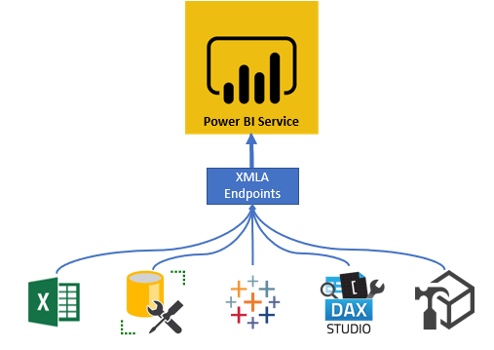

Slide 102

Notes:
Photo by Clay LeConey on Unsplash
There are so many other features

Slide 103
Notes:
It allows access to all the access fabric features that account is permitted to access.
If the capacity is running

Slide 104
Access to Power BI Service
Own workspace to upload to
48 refreshes per day (more if reqd)
Dataset and Dataflow incremental refresh
Securely share with other PPU license users
Access to Workspaces backed by Pro license
AI & ML capabilities
100GB dataset size.

Slide 106
Content sharing
Notes:
Photo by Elaine Casap on Unsplash
The person you want to share with must have a Power BI Licence if want to share securely

Slide 107


Slide 108
 |  | Licence Type can view / access content
 | Licence Type creating content | Pro | Premium Per User | Premium Per Capacity user (no named licence)
Create content with this licence in a workspace | Pro | Yes | Yes | No
 | Premium Per User | No | Yes | No
 | Premium Per Capacity | Yes | Yes | Yes
https://docs.microsoft.com/en-us/power-bi/admin/service-premium-per-user-faq

Slide 109



Pro account
Workspace
Free
PPU
Pro

Slide 110
PPU account
Workspace
Free
PPU
Pro

Slide 111
Power BI Embedded
Notes:
https://enthusiasthome.com/diy-entertainment-center/

Slide 112
Capacity License
Notes:
What if your company wants to transport 60, or 100 people regularly. More people it becomes cheaper to rent the entire bus

Slide 113

Notes:
Photo by Miguel Á. Padriñán from Pexels

Slide 114

This Photo by Unknown Author is licensed under CC BY-SA

Slide 115
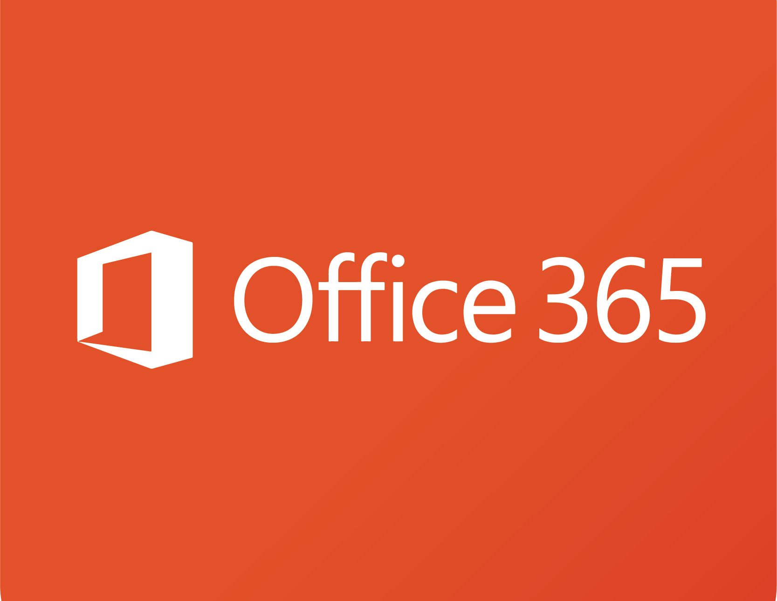
EM- SKU
Notes:
Embedding

Slide 116
Notes:
What are the upsides of Power EM - SKUe

Slide 117



Notes:
This easily allows an organisation to embed Power BI into SharePoint online and Microsoft teams. - Fantastic for an organizational use of Office

Slide 118
Within an organization
(Office 365 tenant)
Notes:
Photo by chris panas on Unsplash
Can share with users in the same OFFICE 365 Tenant ONLY, they only require a Fabric free licence to view reports
One user must have a Power BI Pro account to publish to the service.

Slide 120
Notes:
Photo by Ben White on Unsplash
Can share desktop files for free with anyone who has the application

Slide 121
Name | Dedicated infrastructure | Virtual Cores | Memory (GB) | Peak Renders /Hr | Cost per month | Annual
EM1* | No | 1 | 3 | 1-300 | Approx. £470 | £5.6k
EM2* | No | 2 | 5 | 301-600 | Approx. £935 | £11.2k
EM3 | Yes | 4 | 10 | 601-1200 | £1,881 | £22.5k
* These products are only available to volume license customers only, contact Microsoft to confirm pricing only shown for guidance.
Notes:
Monthly prices - https://jlsql.blog/2018/01/30/power-bi-embedded-sku-differences-and-cost-breakdowns/
https://whitepages.unlimitedviz.com/2017/09/understanding-the-power-bi-capacity-based-skus/
Also cannot get any larger than EM3 SKU

Slide 122
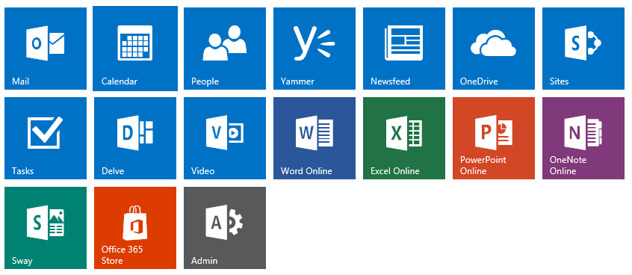
Notes:
This has be purchased via the Office 365 portal
Only if a volume licence customer can only purchase EM-SKU

Slide 123

This Photo by Unknown Author is licensed under CC BY-SA-NC

Slide 124

Notes:
Embedding

Slide 125
Capacity License
Notes:
What if your company wants to transport 60, or 100 people regularly. More people it becomes cheaper to rent the entire bus

Slide 126

Notes:
Photo by Christina Morillo from Pexels
Primarily intended for ISV to integrate into their own systems

Slide 127
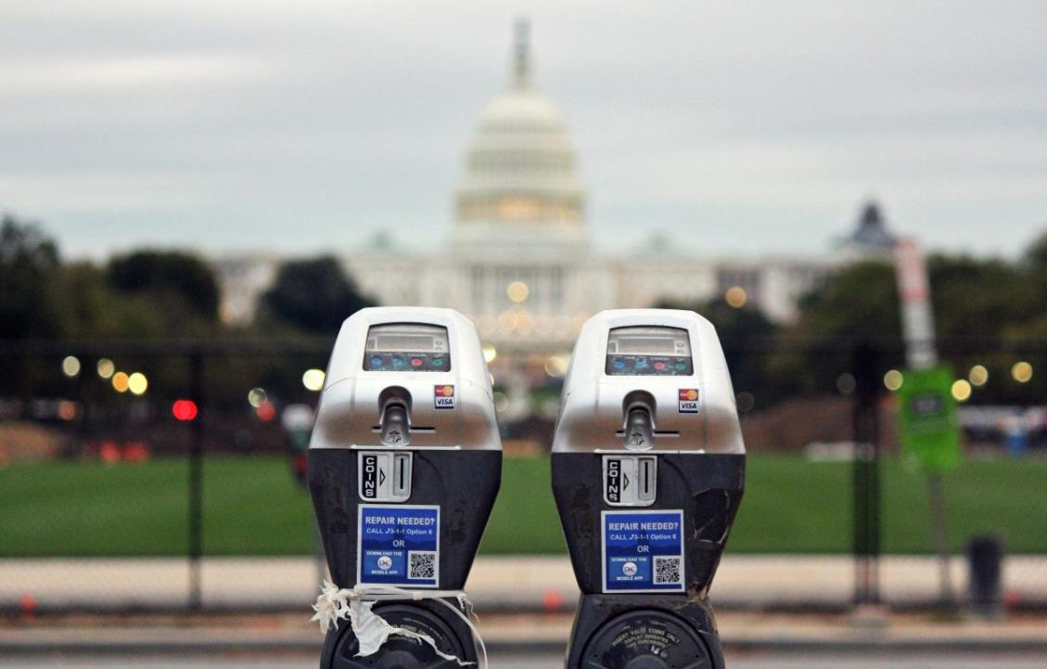
This Photo by Unknown Author is licensed under CC BY-NC
Notes:
The payment model is quite simple its pay as you go.

Slide 128


= £0.00
https://azure.microsoft.com/en-us/pricing/details/power-bi-embedded/
Notes:
This Photo by Unknown Author is licensed under CC BY

Slide 129

£
£
Scale up
Scale Down
Notes:
Does anyone use power later at night?
https://docs.microsoft.com/en-gb/power-bi/developer/embedded/azure-pbie-scale-capacity
A scaling operation can take about a minute. During this time, the capacity will not be available. Embedded content may fail to load.

Slide 130
Share securely with anyone
Notes:
Photo by chris panas on Unsplash
Can share securely using Office 365 or Power BI Service IF the other user has POWER BI PRO

Slide 132
Name | Dedicated Infrastructure | Virtual Cores | Memory (GB) | Peak Renders /Hr | Cost per hour
A1 | No | 1 | 3 | 1-300 | £0.819
A2 | No | 2 | 5 | 301-600 | £1.631
A3 | Yes | 4 | 10 | 601-1,200 | £3.269
A4 | Yes | 8 | 25 | 1,201-2,400 | £6.545
A5 | Yes | 16 | 50 | 2,401-4,800 | £13.097
A6 | Yes | 32 | 100 | 4,801-9,600 | £26.200

Slide 133
Notes:
With the azure embedded SKU you cannot embed EASILY in to sharepoint on line or teams

Slide 134
Can only purchase via Azure Portal

Slide 135

Notes:
Photo by Mikael Seegen on Unsplash

Slide 136
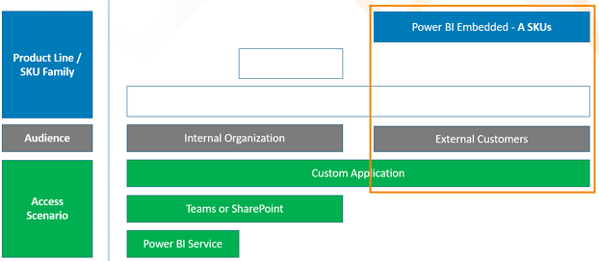
"App owns data"
https://www.bluegranite.com/blog/choosing-between-pbi-premium-or-embedded
Notes:
https://www.bluegranite.com/blog/choosing-between-pbi-premium-or-embedded

Slide 137

Notes:
Photo by Flex Point Security on Unsplash

Slide 138
Power BI Premium
Notes:
Photo by Jp Valery on Unsplash

Slide 139
Capacity License
Notes:
What if your company wants to transport 60, or 100 people regularly. More people it becomes cheaper to rent the entire bus

Slide 140
Notes:
What are the upsides

Slide 141
Share securely with anyone
Notes:
Photo by chris panas on Unsplash
Can securely share with anyone

Slide 142
Premium
Workspace
Pro
Free
PPU

Slide 143
Notes:
Photo by Ivan from Pexels
Larger model size 400GB compared to 100GB for PPU
Up to 48 refreshes a day

Slide 145

Notes:
Photo by Pixabay: https://www.pexels.com/photo/earth-wallpaper-41953/
Multi-geo deployment management

Slide 146

Notes:
Photo by Karsten Würth on Unsplash
Auto scale add-on availability

Slide 147

Notes:
Photo by Pixabay: https://www.pexels.com/photo/brass-ornate-vintage-key-on-black-computer-keyboard-39389/
power bI Bring your own key (BYOK)

Slide 148
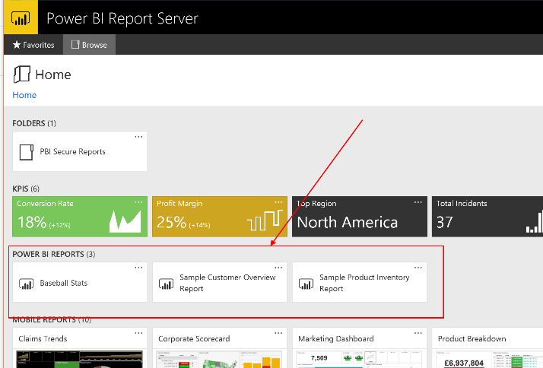

Slide 149

This Photo by Unknown Author is licensed under CC BY-SA

Slide 151
Name | Virtual Cores | Memory (GB) | Backend Cores | Frontend Cores | Peak Renders /Hr | Cost per month | Annual
P1 | 8 | 25 | 4 | 4 | 1,201-2,400 | £4,926.72 | £59k
P2 | 16 | 50 | 8 | 8 | 2,401-4,800 | £9858.36 | £118k
P3 | 32 | 100 | 16 | 16 | 4,801-9600 | £19,721.64 | £236k
P4 | 64 | 200 | 32 | 32 | 9,601-19,200 | £39,448.20 | £474k
P5 | 132 | 400 | 64 | 64 | 19,201-38,400 | £78901.32 | £947k
Notes:
Out of date costs

Slide 152

Notes:
Photo by Aziz Acharki on Unsplash

Slide 153

Notes:
Photo by Call Me Fred on Unsplash

Slide 154

Notes:
Photo by Ekaterina Grosheva on Unsplash

Slide 155
…..the story
so far…..

Slide 156
Name | Capacity Units | A-SKU | P-SKU | Cost per hour
F2 | 2 | N/A | N/A | £0.309
F4 | 4 | N/A | N/A | £0.617
F8 | 8 | A1 | N/A | £1.235
F16 | 16 | A2 | N/A | £2.470
F32 | 32 | A3 | N/A | £4.939
F64 | 64 | A4 | P1 | £9.879
F128 | 128 | A5 | P2 | £19.757
F256 | 256 | A6 | P3 | £39.515
F512 | 512 | A7 | P4 | £79.029
F1024 | 1024 | A8 | P5 | £158.058
F2048 | 2028 | N/A | N/A | £316.117

Slide 157
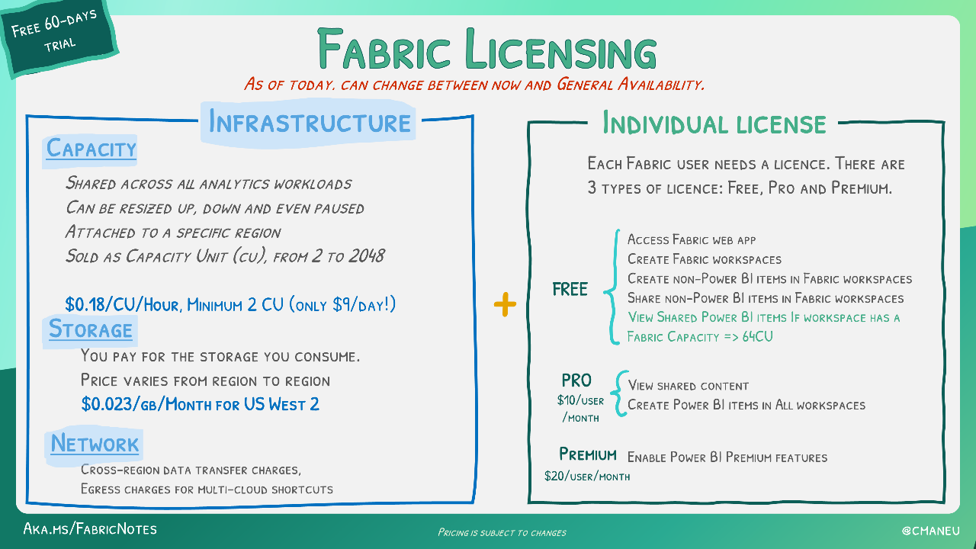
Notes:
https://microsoft.github.io/fabricnotes/images/notes/13-fabric-licensing.png

Slide 158

Notes:
Photo by Andrea Piacquadio: https://www.pexels.com/photo/close-up-photo-of-shocked-woman-with-brown-curly-hair-3764398/
This next table made me surprised

Slide 159
Scenario | Azure (F-SKU) | Azure (A-SKU) | Office (P- SKU)
Embed for Customers (app owns Data)
Embed for your Organisation (app owns Data)
Microsoft 365 Apps (Embed in Teams Embed in Share Point Embed in Power Point)
Secure URL Embedding (embed from Power BI Service)
https://learn.microsoft.com/en-us/power-bi/developer/embedded/embedded-capacity#which-sku-should-i-use
Notes:
https://learn.microsoft.com/en-us/power-bi/developer/embedded/embedded-capacity#which-sku-should-i-use

Slide 160

Notes:
Photo by <a href="https://unsplash.com/@mrthetrain?utm_source=unsplash&utm_medium=referral&utm_content=creditCopyText">Joshua Hoehne</a> on <a href="https://unsplash.com/photos/Nsaqv7v2V7Q?utm_source=unsplash&utm_medium=referral&utm_content=creditCopyText">Unsplash</a>

Slide 161

Notes:
Photo by <a href="https://unsplash.com/@stayandroam?utm_source=unsplash&utm_medium=referral&utm_content=creditCopyText">Gemma Evans</a> on <a href="https://unsplash.com/photos/zj475haUy2M?utm_source=unsplash&utm_medium=referral&utm_content=creditCopyText">Unsplash</a>

Slide 162
Reserved instances
(RI-SKU?)

Slide 163
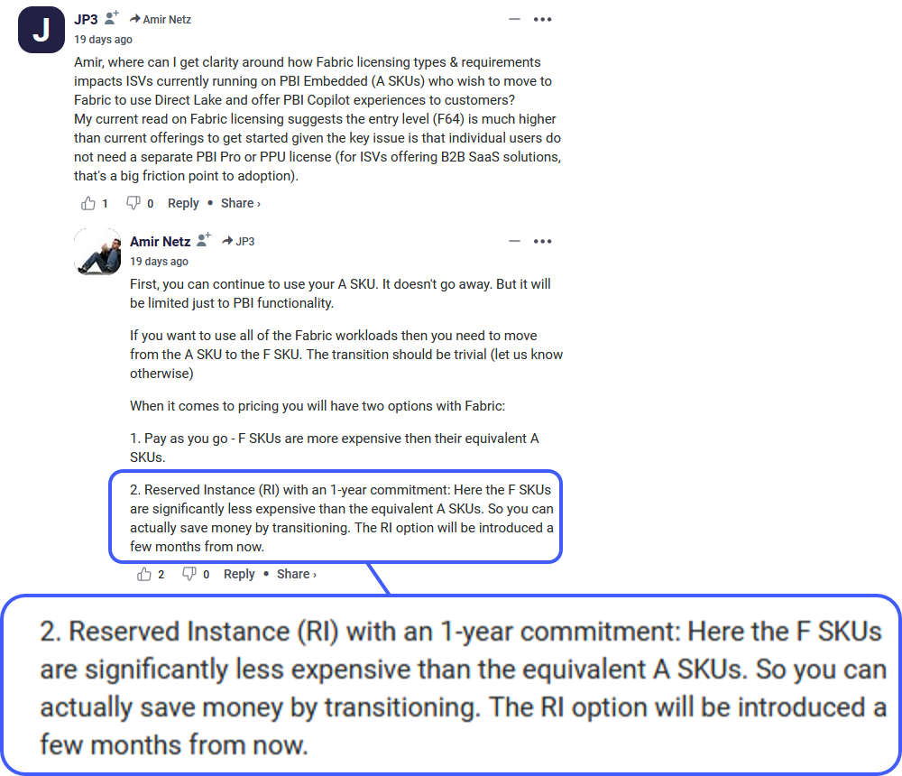

Slide 164





Slide 165

Notes:
Photo by Brendan Church on Unsplash
What are the other choices? Or do you have to take what Microsoft offers and be stratified with that?

Slide 166
Notes:
Photo by Diana Parkhouse on Unsplash

Slide 167

Notes:
Photo by Nick Fewings on Unsplash

Slide 168


Slide 169
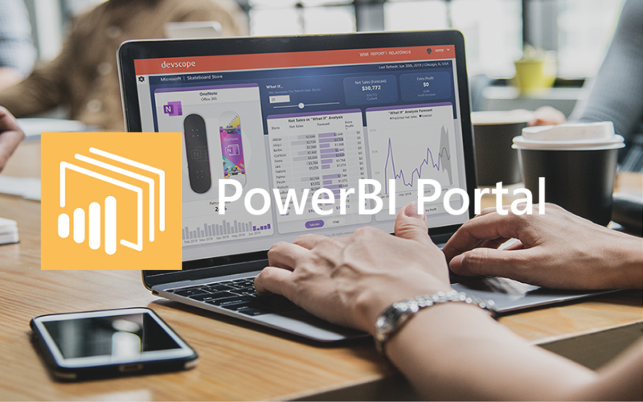

Slide 170
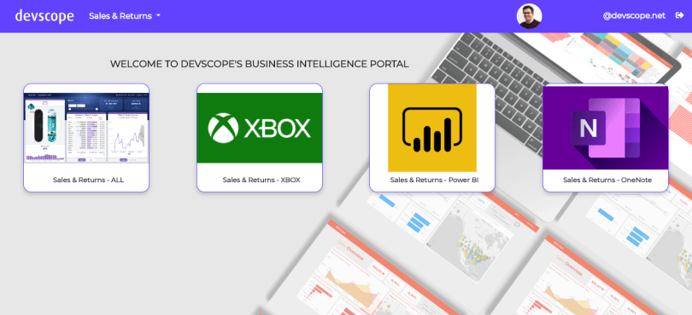

Slide 171

Notes:
Photo by Anders Jildén on Unsplash
Before we get to some Total Cost Of Ownership costs
Want to ask the question do you leave the lights on in your building if no on is using them?

Slide 172



Slide 173

Share securely with anyone
Notes:
Photo by chris panas on Unsplash
Can share securely using Office 365 or Power BI Service IF the other user has POWER BI PRO

Slide 174


Slide 175

Notes:
Photo by Adrian Bar on Unsplash
There are several components to this solution, so lets look at them before getting to the bottom line

Slide 176




4 required components
Notes:
SQL server database
Azure Blob Storage
2 X App Services
PowerBI A SKU

Slide 177

€ 3499.00 per annum
(£3.2k approx.)

Slide 178
Power BI SKU | Total Monthly cost | Total Yearly Cost
A1 | £564 | £6,759
A2 | £728 | £8,726
A3 | £1,058 | £12,693
A4 | £1856.58 | £22,278.96
P1 | £4,927 | £59,120 (for comparison only)
Pricing includes
Dev Scope Power Portal – 12 month contract
Azure SKU running for 10 hours per day, Monday to Friday Only
Azure Service never paused
Azure SQL Database
2 x Azure App Services
Azure storage service

Slide 179

Really ? No, I do not believe it…..
Notes:
Photo by Sean Nyatsine on Unsplash

Slide 180

Notes:
Photo by Kelly Sikkema on Unsplash

Slide 181
Working days in a year
52 weeks
5 working days
52 x 5 = 260
Working days per month
260 / 12 = 21.6667
22 working days per month

Slide 182
Devscope Power BI Portal
Annual cost = 3,499.00 €
Annual cost = £3,200.00
Monthly cost = £ 266.67

Slide 183
£13.72 per month
£15.22 per month
£102.29 per month
£165.30 per month (220 hours)
1 X A1 SKU
4 required components

Slide 184

Oi’ beardy
Show ‘em the
calculator

Slide 185
 | Cost Per Month
DevScope Power BI Portal | £ 266.67
Azure SQL Database | £13.72
App Service (x2) | £111.49
Storage Account | £16.60
Power BI A4 Embedded 220 hours usage | £1439.90
Power BI Pro Licence x 1 | £8.20
Total Monthly Estimated Cost | £1856.58
Total Yearly Estimated Cost (as of May 2022) | £22,278.96
https://azure.com/e/9b291a23fad540d6a6d928234774b706

Slide 186

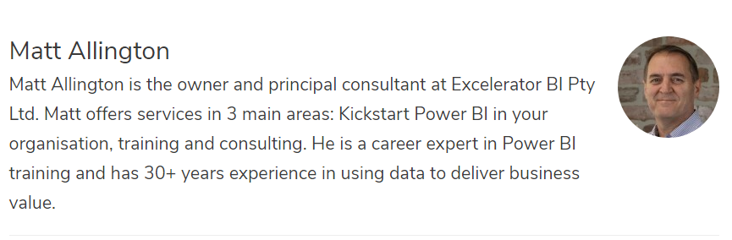
https://exceleratorbi.com.au/

Slide 187
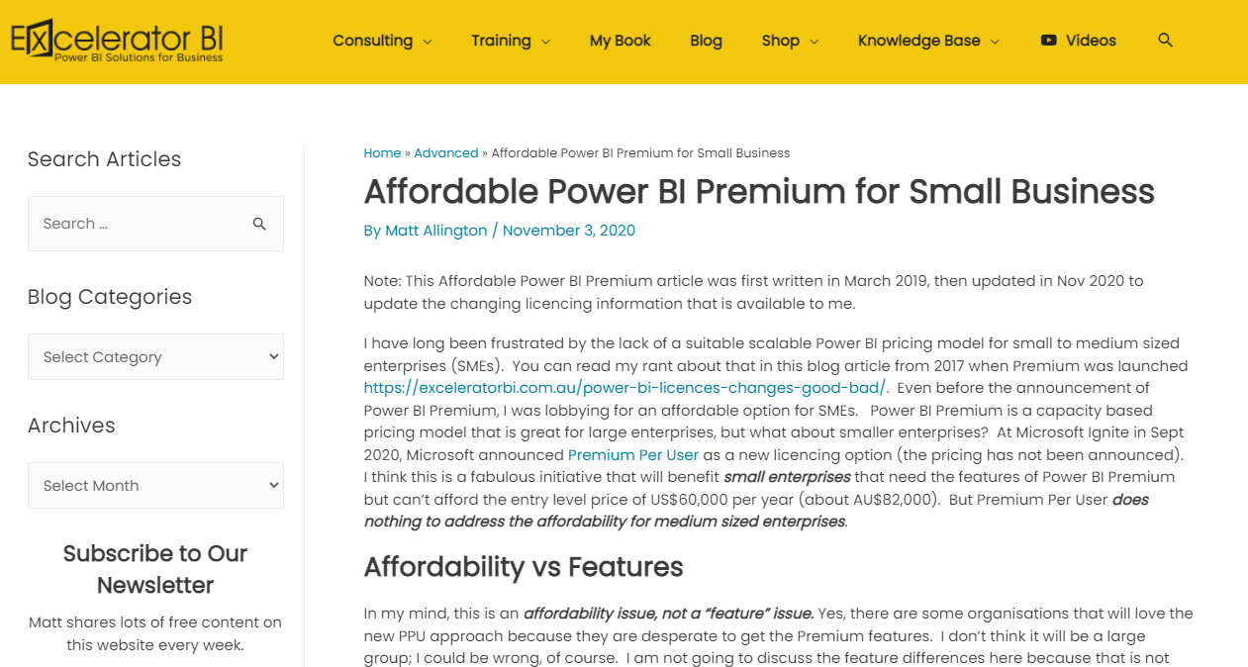
https://exceleratorbi.com.au/affordable-power-bi-premium-for-small-business/

Slide 188
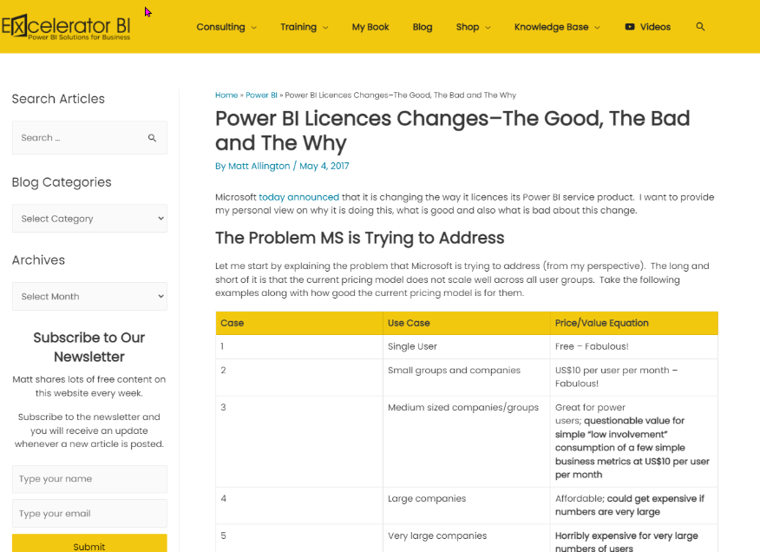
https://exceleratorbi.com.au/power-bi-licences-changes-good-bad/

Slide 189
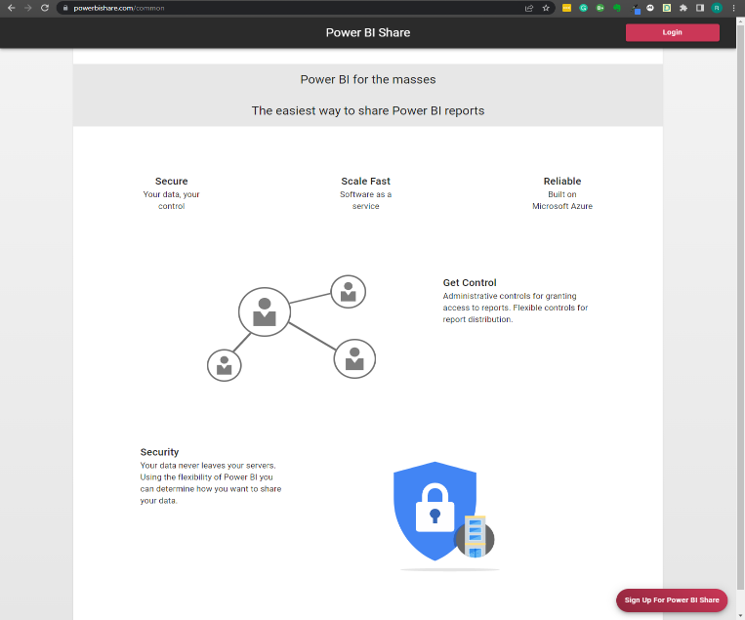
https://www.powerbishare.com
Notes:
Hi Matt, I was interested in confirming the details of the pricing for www.powerbishare.com.
$2000 set up cost, this is one-off payment? $2 per named user /login per month - is this an annual cost that is payable every year? The only other cost for an organisation that might want to use this service. They are required to have an A-SKU, and at least one Power BI Pro licence. From what I see there are no other requirements?
If they want to start/stop the Capacity, they will need some power automate credits and there is a small cost for that. It should be less than $20 per month.

Slide 190
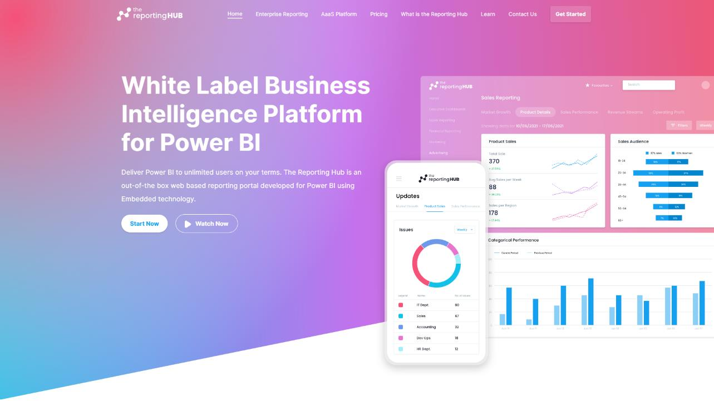
https://thereportinghub.com/

Slide 191
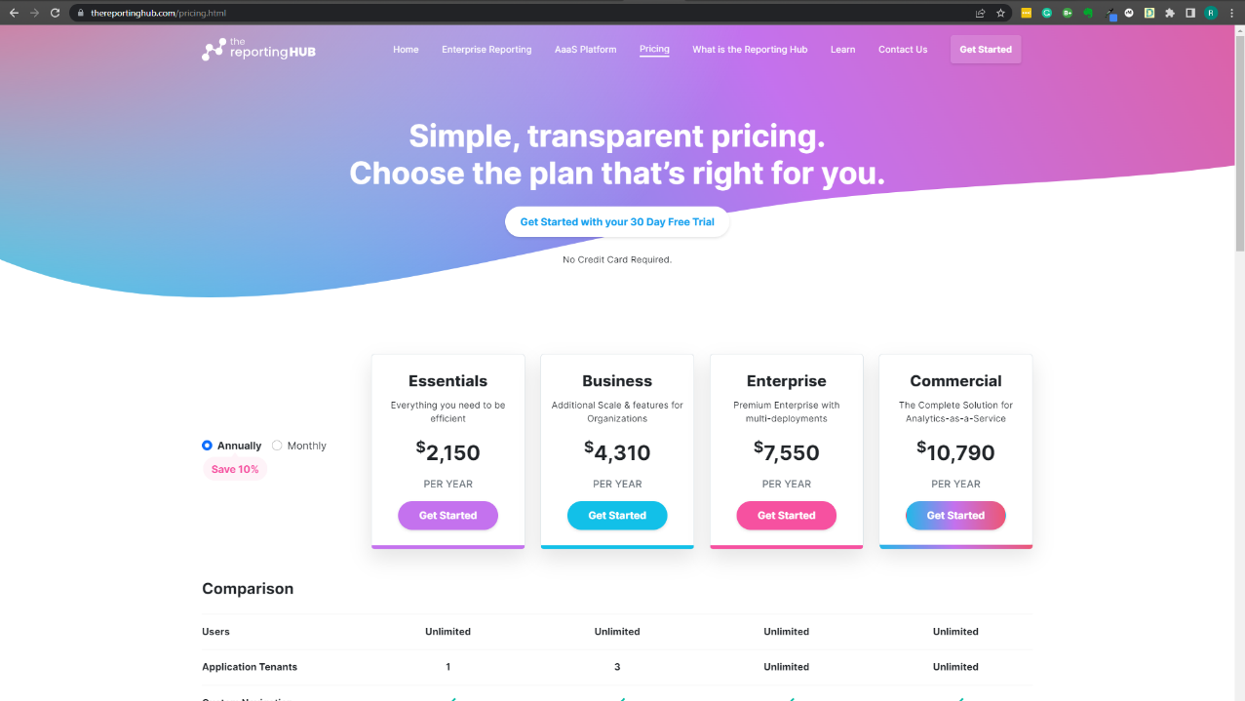

Slide 192
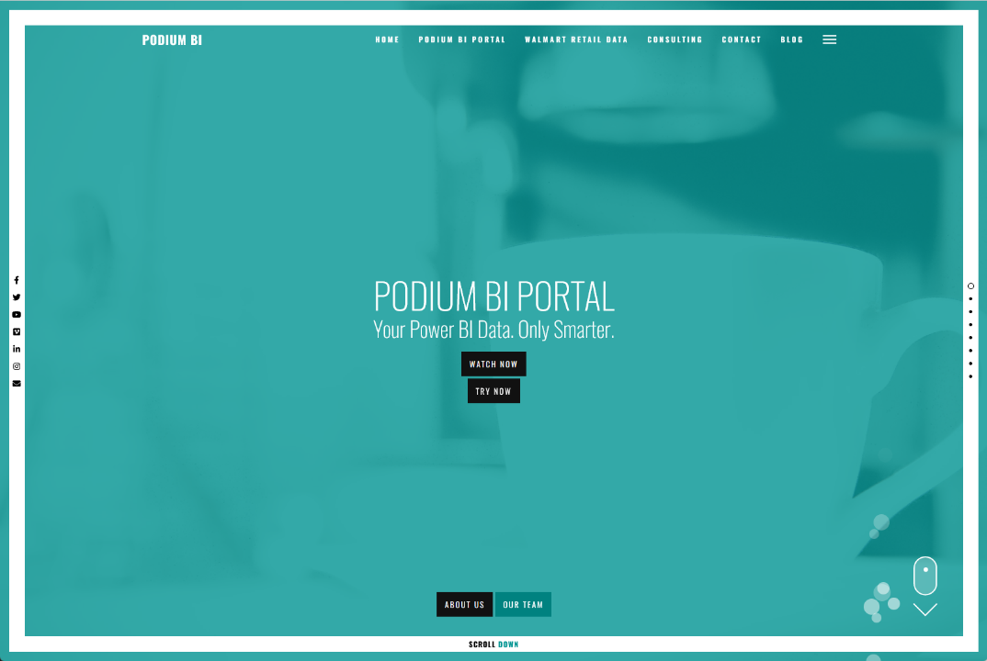
https://www.podiumbi.com/powerbi-reporting-software/

Slide 193
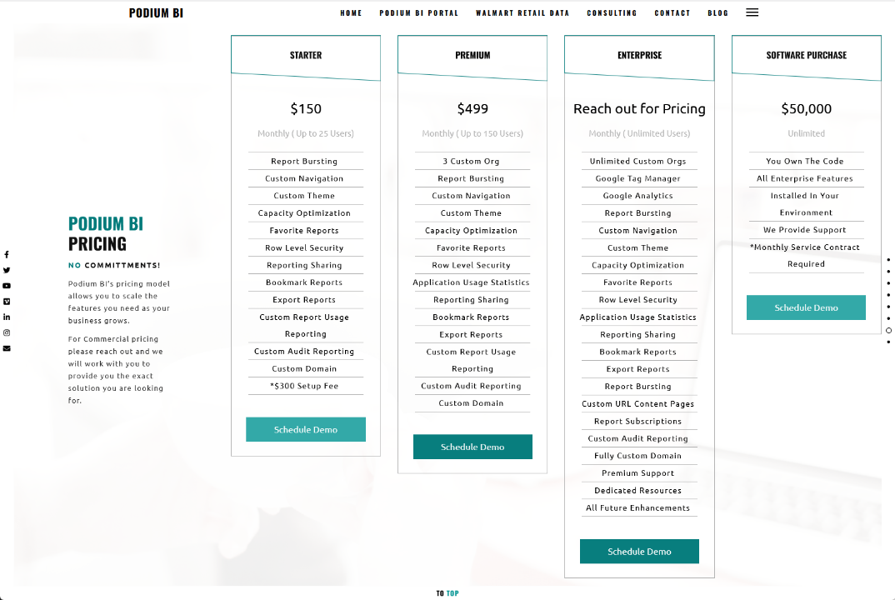

Slide 194

Notes:
Photo by Jake Young on Unsplash

Slide 195

TL;DNL -Too long did not listen!
Notes:
Photo by Mariam Soliman on Unsplash
Fair enough I would get bored if I heard me talking for the length of time

Slide 196

Notes:
Photo by Milada Vigerova on Unsplash

Slide 197

Notes:
Photo by Ann H from Pexels

Slide 198
User license
Notes:
Personal license – to allow anyone to ride on a bus in Glasgow you have purchase a ticket, this could be a season ticket so you can ride at any time. Only one person at a time can use that ticket though

Slide 199
Notes:
Photo by William White on Unsplash

Slide 201


Slide 202
Capacity License
Notes:
What if your company wants to transport 60, or 100 people regularly. More people it becomes cheaper to rent the entire bus

Slide 203
Power BI Embedded
Notes:
https://enthusiasthome.com/diy-entertainment-center/

Slide 204
EM- SKU
Notes:
Embedding
The office EM-Sku makes it easy to share reports within an organization
Have to sign up to a minimum of a 12 month contract which is a fixed price
CANNOT SHARE WITH EXTERNAL CUSTOMERS – although the inviting external users to the Azure AD MIGHT work?

Slide 205
Notes:
Azure Embedded is another option
Scalable not fixed contract requires more work to set up and maintain
Does have an advantage certain use cases

Slide 206
Power BI Premium
Notes:
Photo by Jp Valery on Unsplash

Slide 207

Notes:
There are other choices though !
If you are prepared to do some work and think outside the Box

Slide 208
Notes:
Photo by Diana Parkhouse on Unsplash

Slide 209
Notes:
Dev Scope Power BI portal –
Sits on top of the Azure embedded SKU so costs more then implementing just A-SKU
Offers ability to share with any customer
Offers built in security and customisation
Could be cheaper then Premium and yet allow sharing with external customers

Slide 210
https://www.powerbishare.com

Slide 211
https://thereportinghub.com/

Slide 212
https://www.podiumbi.com/powerbi-reporting-software/

Slide 213

Notes:
Photo by Jan Baborák on Unsplash
Who is in control of the costs with the last three options?
Who is in the driving seat controlling the costs.

Slide 214

Notes:
Photo by fauxels from Pexels
Not interest in selling to you a solution which does not work for you, what I would like to do is find a solution which meets your specific needs. So LETS HAVE A CONVERSTATION

Slide 215
Trust, but verify.
Ronald Regan
Notes:
Photo by Cytonn Photography on Unsplash

Slide 216
Robert French
Data Shepherd,
Data Plumber ,
Data Dance Teacher
Email -
Robert.French@qnrl.com
@sqlbobscot
#DressUpFriday
Linked In - https://www.linkedin.com
/in/rwlpfrench/
Website - https://www.qnrl.com/

Slide 217
bit.ly/3pBLowQ

Slide 218

Notes:
Photo by Wilhelm Gunkel on Unsplash

Slide 219

Notes:
Photo by Edwin Andrade on Unsplash

